Slide 1

Introduction to model deployment: streamlit.
DATA ANALYTICS | IRONHACK

Slide 2

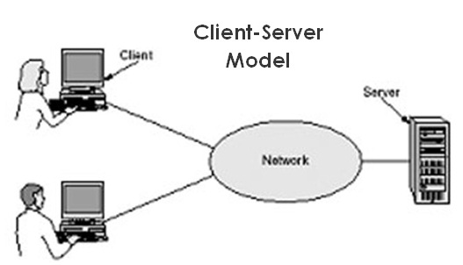
IRONHACK BOOTCAMP
MODEL DEPLOYMENT: THE PROBLEM
Once the model is created, you will need to serve it to the client.
The client doesn’t know anything about Python, Jupyter notebooks...etc.
The client wants to get a way to input data and obtain a prediction.
This brings us to the client-server model.

Slide 3
IRONHACK BOOTCAMP
MODEL DEPLOYMENT: THE CLIENT
The client would like to have an interface to input the data about observation/s and get get a prediction in his own computer.
This forces us to create this interface to isolate the data exploration from the model predictions. ( The client wants a quick prediction and he doesn’t care about the problems with data ).
This model leaves us with interface + model ( which has to be created alongside with any preprocessing before serving the model )

Slide 4
IRONHACK BOOTCAMP
MODEL DEPLOYMENT: THE SERVER
The server will be one or more computers listening for new data to provide predictions using our model.
Those computers can be:
On premises ( in house/company computers )
Cloud computing
In this course, we are going to simulate an “on premises” computer using our own computers for sake of simplicity*.
*Proper modeling will involve advanced topics not covered in this course.

Slide 5

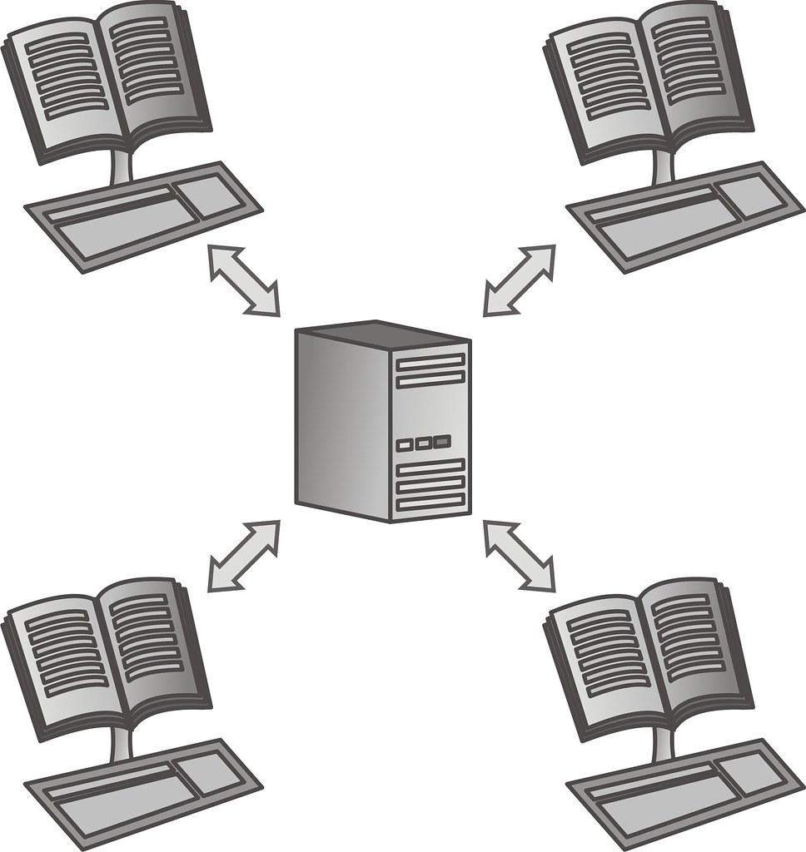
IRONHACK BOOTCAMP
MODEL INFRASTRUCTURE:
There are several ways to provide an environment to deal with the client - server model.
REST API
Load balancing

Slide 6
IRONHACK BOOTCAMP
STREAMLITE
The server will be our computer
We will play the role of client and server

Slide 7
IRONHACK BOOTCAMP
ELEMENTS STREAMLIT APPLICATION
The application: deploy-model.py ( python code )
The model: ( model.pkl )
The scaler ( scaler.pkl if needed )
The preprocessing ( functions.py if needed )
You will need to install the “streamlit” library..

Slide 8
IRONHACK BOOTCAMP
STREAMLIT APPLICATION
You need to create a Python script *.py with code to:
Read data
Preprocess data
Load scaler
Load model
Apply the scaler
Use model to make predictions

Slide 9
IRONHACK BOOTCAMP
RUNNING THE STREAMLIT APPLICATION (I)
In windows:
Navigate to the folder application in the file browser
Press Shift on your keyboard and Right Click on your mouse
Left-click Open PowerShell window here
In MacOS:
Go to the apple icon -> System preferences -> Shortcuts
Select “New terminal in folder” -> assign a keystroke.
Use finder to navigate to the folder and open a terminal there.

Slide 10
IRONHACK BOOTCAMP
RUNNING THE STREAMLIT APPLICATION (II)
In the terminal type:
streamlit run deploy_model.py
This will open a new tab in your browser with the application.

Slide 11


